Slide 1

DEPARTMENT OF ARTIFICIAL INTELLIGENCE AND DATA SCIENCE
Artificial Neural Networks and Deep Learning: 21ADG64
LA1 - Seminar
Introduction to Gradient Descent
Presented By
Aditya Kumar
[NT21AD003]
Name of the Course Instructor Dr Meenakshi

Slide 2

CONTENTS
Introduction and Motivation
Methodology and Approach
Results and Analysis
Conclusion and Future Recommendations
Demo video of code
Github link of PPT and Code
References

Slide 3
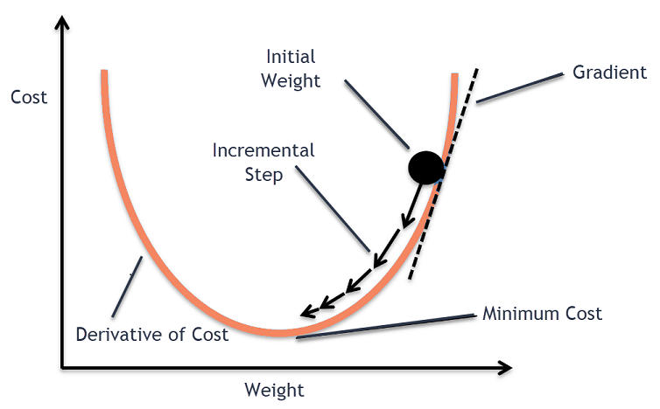
INTRODUCTION
What is Gradient Descent?
Gradient descent is a fundamental optimization algorithm used in machine learning and deep learning.
It aims to minimize an objective function (often referred to as a loss function) by iteratively adjusting the model’s parameters.
The key idea is to move the model along a slope or gradient toward the lowest possible error value.

Slide 4
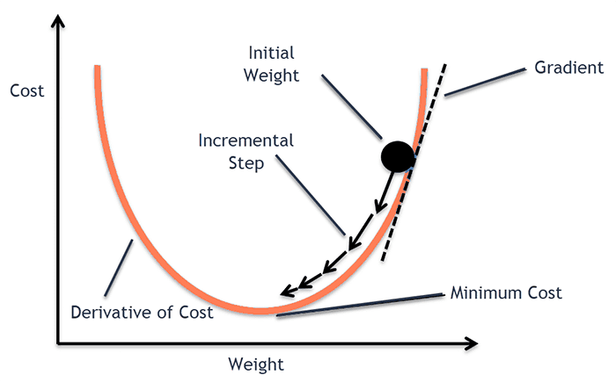
Motivation – Importance in Deep Learning
Gradient Descent plays a pivotal role in training neural networks.
It helps optimize the model’s weights and biases by minimizing the cost function during training.
Without gradient descent, neural networks wouldn’t learn effectively.

Slide 5

What is Gradient?
A gradient measures how much the output of a function changes if you change the inputs a little bit
A gradient simply measures the change in all weights with regard to the change in error.
You can also think of a gradient as the slope of a function. The higher the gradient, the steeper the slope and the faster a model can learn
But if the slope is zero, the model stops learning

Slide 6
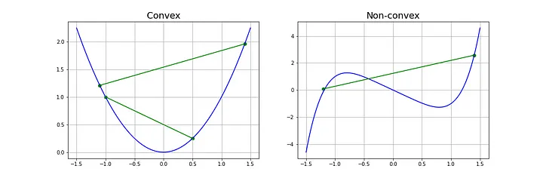

Requirements
Gradient descent algorithm does not work for all functions. There are two specific requirements. A function has to be:
Differentiable :If a function is differentiable it has a derivative for each point in its domain
Convex : for two points x₁, x₂ laying on the function’s curve this condition is expressed as:
06-04-2024

Slide 7
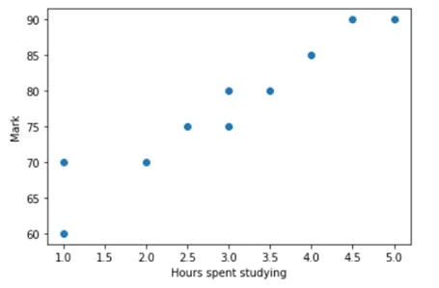
Methodology and Approach– Understanding Cost Function
Let me explain this with the help of linear regression. For simplicity, let us take the problem as follows
We have to find the mark of a student given the number of hours they studied
When we plot this for a fictional dataset, we would get a scatter plot that looks something like this

Slide 8
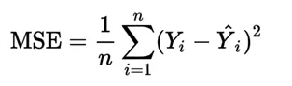
Methodology and Approach - Continued
We can have so many lines that connect these data points, but we need a single line that is the best fit
To find this best fit, we introduce a term called cost function, which is nothing but the error function
Mean squared error (MSE) : by subtracting the actual value and the predicted value, for each data point and this difference is then squared

Slide 9
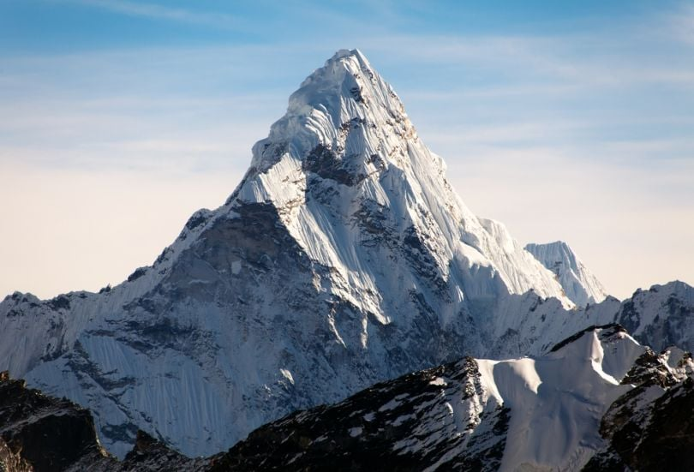
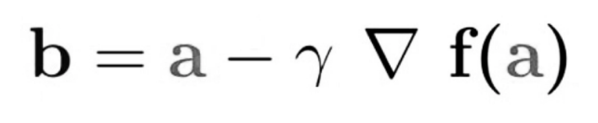
How Gradient Descent Works
Think of gradient descent as hiking down to the bottom of a valley.
This is a better analogy because it is a minimization algorithm that minimizes a given function
The equation below describes what the gradient descent algorithm does: b is the next position of our climber, while a represents his current position. The minus sign refers to the minimization part of the gradient descent algorithm. The gamma in the middle is a Leaning rate and the gradient term ( Δf(a) ) is simply the direction of the steepest descent.

Slide 10
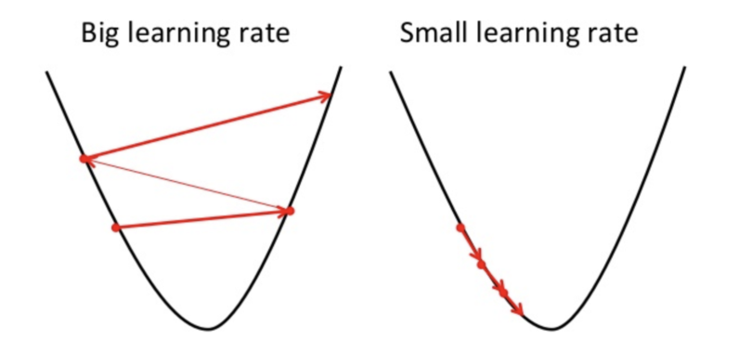
Gradient Descent Learning Rate
The steps gradient descent takes into the direction of the local minimum are determined by the learning rate
For the gradient descent algorithm to reach the local minimum we must set the learning rate to an appropriate value, which is neither too low nor too high
This is important because if the steps it takes are too big, it may not reach the local minimum because it bounces back and forth
If we set the learning rate to a very small value, gradient descent will eventually reach the local minimum but that may take a while

Slide 11
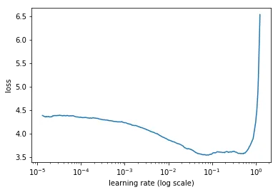
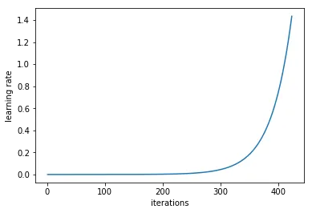
Results and Analysis – How to Find Optimal Learning Rate
N. Smith describes a powerful technique to select a range of learning rates for a neural network in section 3.3 of the 2015 paper “Cyclical Learning Rates for Training Neural Networks”
The trick is to train a network starting from a low learning rate and increase the learning rate exponentially for every batch
Record the learning rate and training loss for every batch. Then, plot the loss and the learning rate
We need to select a point on the graph with the fastest decrease in the loss. In this example, the loss function decreases fast when the learning rate is between 0.001 and 0.01.

Slide 12
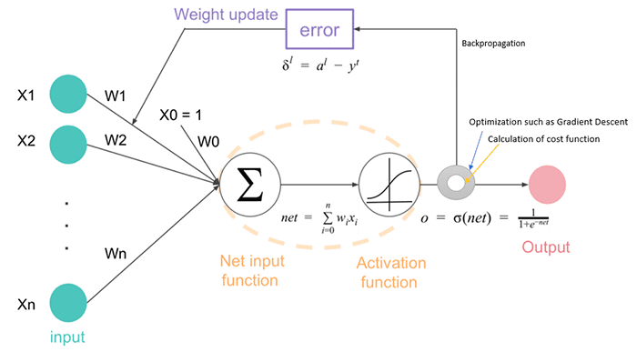
Conclusion and Future Recommendations
A neural network consists of one or more hidden layers. Each layer consists of a set of parameters. Our goal is to optimize these parameters such that our loss is minimized.
Typical loss functions include binary cross-entropy (two-class classification), categorical cross-entropy (multi-class classification), mean squared error (regression), etc.

Slide 13
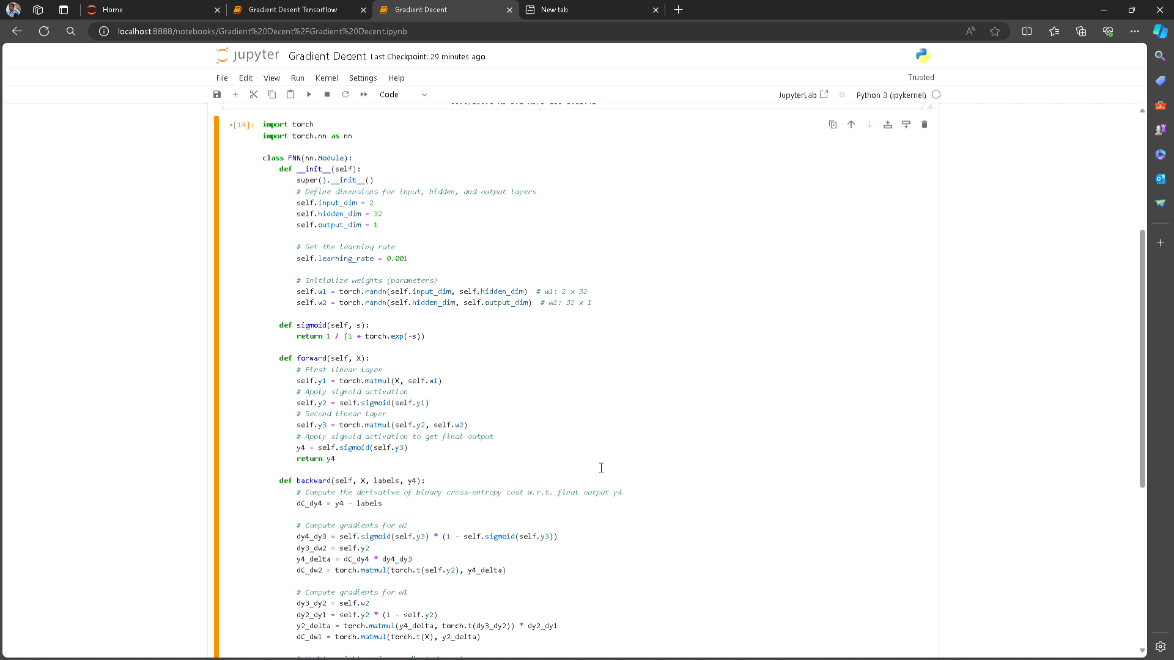
Demo video of code

Slide 14
Github link of PPT and Code
Github link : https://github.com/Aditya-professional-life/Gradient-Desent/tree/main
PPT link : https://github.com/Aditya-professional-life/Gradient-Desent/tree/main

Slide 15

References
Medium : https://machine-learning-made-simple.medium.com/improving-gradient-descent-for-better-deep-learning-with-natural-gradients-327e5faa836a
TowardsDataScience : https://towardsdatascience.com/estimating-optimal-learning-rate-for-a-deep-neural-network-ce32f2556ce0
Biultin : https://builtin.com/data-science/gradient-descent
Machinelearningmastery : https://machinelearningmastery.com/gradient-descent-for-machine-learning/

Slide 16

Thank You

